Slide 1

Commercial Overview

Slide 2
1
2
3
4
Commercial Benefits
Scenarios and Solutions
Customer Base
Release Summary
5
6
Hardware Benefits and Portfolio
V-FLEX Licensing

Slide 3
Commercial Benefits

Slide 4

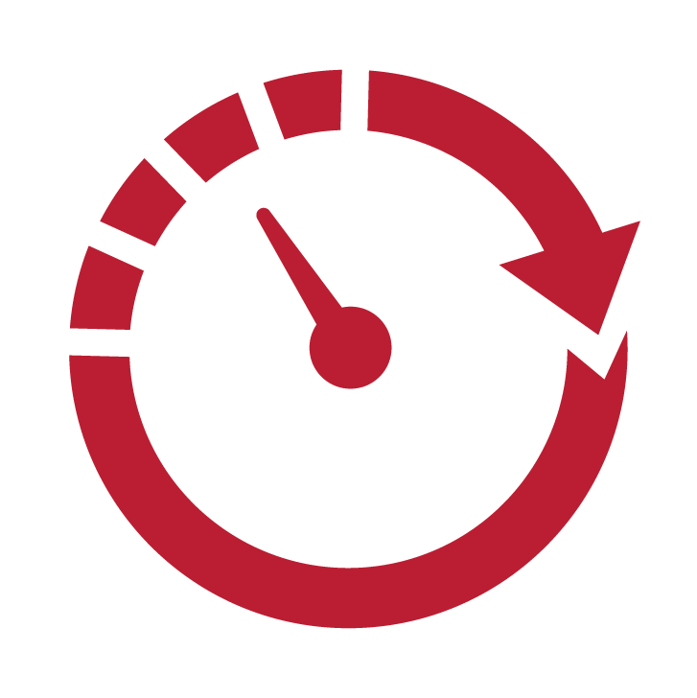
Why Customers Use ThinManager®
1
Configuration Wizards
Easily select the functionality you
need without any coding
Ease of use
  No local configuration of thin client required
  Admin console and terminal to terminal shadowing
  Industrial thin clients & broad touch screen support
  Control thin client session inside application (ActiveX control)
2
Reduce Downtime
  Automatic Remote Desktop Server failover
  Redundant networking options at thin client
  Aggregate multiple content sources at 1 terminal
Quick Replacement
Most ThinManager® thin clients can be replaced by anyone in under 2 minutes without any loss of data
Improve Operational Efficiencies
  OT-Centric solution designed for the plant floor
  Visualize content with tiling & virtual screening
  IP/USB Camera integration
  Location-based mobility (Relevance®)
3
Notes:
ThinManager-managed devices are managed centrally using the Admin Console – no configuration is required at the device.
This makes terminal replacement extremely simple. In fact, anyone can be trained to perform a terminal replacement, significantly reducing downtime.
ThinManager is purpose-built for manufacturing environments, due to its evolution on the plant floor for the last 18 years.
As opposed to managing numerous PCs (either physical or virtual), each with their own Windows OS and applications to maintain, ThinManager presents a much simpler centralized management paradigm.
The ThinManager OS is delivered to a thin client right at boot time, and its configuration is easily created and managed within the ThinManager Admin Console.
Windows-based content can be made highly available by simply configuring a failover Remote Desktop Server. If the primary Remote Desktop Server becomes unavailable, the thin client will automatically fail to the secondary Remote Desktop Server.
ThinManager supports over a dozen touchscreen drivers – and you won’t have to figure out where to install the driver (on the server, thin client, etc.) – you simply add the correct driver to the terminal’s profile.
ThinManager also support redundant networking on thin clients with more than one network interface card (NIC).
Any terminal managed by ThinManager can be remotely monitored and/or controlled from the ThinManager Admin Console.
This shadowing concept can be taken a step further where ThinManager enables terminals to shadow each other.
The real power of ThinManager is its ability to aggregate multiple content sources at a single device (i.e.: Windows based applications, cameras, VNC sessions to PanelViews, etc.), creating composite applications. These multiple content sources can be visualized simultaneously using Tiling or Virtual Screening.
ThinManager also provides location based content delivery to mobile devices, so content can be made available only in the physical locations that permit it.
Lastly, ThinManager ships with an ActiveX control called TermMon which extends ThinManager functionality natively to ActiveX containers, like FactoryTalk View SE.
Two of the best reasons to use ThinManager are listed in the gray boxes. Every asset managed by ThinManager can be configured using the configuration wizard tool. Simply select the settings you want and deploy with no coding required.
When a ThinManager-managed terminal does fail, it can be replaced in minutes instead of hours with no loss of data. Replacement is so simple that anyone who can plug in power, network and monitor cables can replace a ThinManager terminal.

Slide 5
ThinManager®
Competitive Strengths and Weaknesses
ThinManager® has no direct competition | Citrix | VMware View | Dell-Wyse | ThinManager®
Supports thin clients with NO OS or storage media
Supports multiple sources of data, including Remote Desktop Servers, Virtualization, IP/USB Cameras, and other Thin Clients
Supports multiple hardware types and suppliers, including industrial devices with touch screens and no OS installed
Centralized management of Client content and setup for a wide range of device types
Ability to assign content from multiple sources to a Device, User and/or Location rather than just a terminal device
Over a decade of doing business with Industrial thin client systems
Ability to update client side OS and configuration by a simple reboot
Notes:
Competition – Citrix and VMware
Citrix and VMware are sometimes considered competitive products to ThinManager. We do not consider them as such. ThinManager supports part of the Citrix protocol. ThinManager also works directly with VMware to allow virtual machine delivery to be managed with ThinManager.
VMware View Connection Server
Citrix XenDesktop Delivery Controller
The Primary role of the connection broker is to deliver desktops or applications from centralized VDI server platforms to end point devices base on predefined or on-demand computing or user requirements.
Citrix and VMware Argument
Organizations that use Citrix and VMware may argue that they can do everything that ThinManager can do with their respective products. This is a common misunderstanding. The reality is…
Citrix and VMware focus on the server side of the equation and they do not manage the client devices.
Citrix and VMware do not support resolving technology in a mobile environment.
Citrix and VMware do not sell products that are designed specifically for manufacturing environments.
ThinManager is the only thin client management tool that provides enabling for “industrial” client hardware.
ThinManager Beyond the Connection Broker
In addition to acting as a connection broker, ThinServer and ThinManager facilitates configuration and management of the following:
Endpoint device specific hardware features like video resolution and sound
Endpoint device peripherals like Touch Screens, Flash Disks, Keyboards, HID readers or Biometric devices
Endpoint device remote booting including PXE-based firmware delivery, firmware packaging and updates, and DHCP services
Endpoint device and User authentication, content assignment and content display profiles
IP video servers configuration and video content display management
Hardware level client to client shadowing
Mobile device location resolving, location-based content delivery
More Exclusive ThinManager Features
Server load balancing
Server session queuing
VMware server management
Integrated Active Directory support
Integrated IP camera support
Share keyboard and mouse between terminals
Multiple simultaneous terminal users (MultiStation)
Instant session failover
Automated terminal replacement
Redundant network failover
Biometric and RFID authentication
Application delivery based on Biometric Input
Application delivery based on RFID Input
Integrated on-screen keyboard
Virtual Terminal
Remote touch screen calibration
No configuration stored on terminal
Support for numerous terminal hardware vendors
Integrated user configurable reporting
Email, Text notifications and alerts
Redundant synchronized configuration

Slide 6

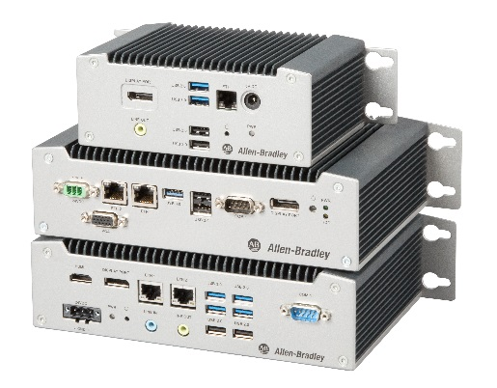
Replace PCs with thin clients to reduce maintenance and downtime
Enhance the end user experience on all devices by delivering role-based content in a customized layout
Increase security by reducing your network attack surface area
Deploy the most secure industrial mobility solution without writing or rewriting any code
Industrialized thin client terminals outlast PCs by years and lower TCO
Deliver current applications to virtually any device
No data is stored on ThinManager thin clients
Use location resolvers to restrict mobile delivery to authorized locations
…and supports the
Allen-Bradley VersaView 5200 thin clients
Remove OSs from the plant floor, consolidate applications to a few servers
Have applications follow users from terminal to terminal
with a simple login
Deliver only the applications you want users to access without a desktop
Deliver content to iOS, Android and Windows 10 or higher mobile devices
Replace down
terminals in minutes instead of hours
Control exactly how applications are displayed across every monitor
ThinManager terminals will not accept mass storage devices like USB thumb drives
No data from mobile sessions is ever stored on the ThinManager-managed devices
Productivity
Visualization
Security
Mobility

Slide 7
Scenarios and Solutions

Slide 8






Challenge #1 : Access remote Terminals
CHALLENGE
SOLUTION
Long line or machine
Multiple areas with dedicated HMI terminals
ONE operator
Temporary access to remote terminal
ThinManager Terminal Shadowing
Role based : RFID badges
Lock-out option (aka terminal transfer)
Content follows the user
Shadow
OR
Lock-out
RFID

Slide 9




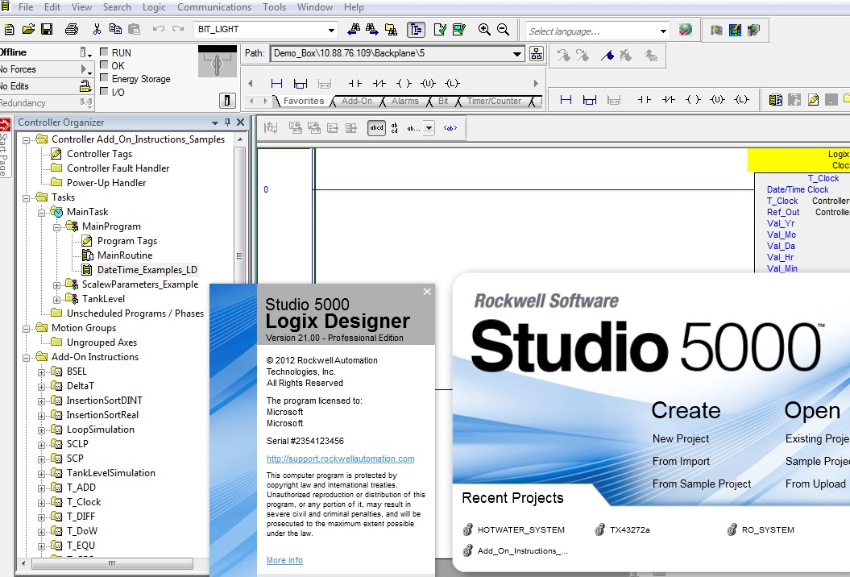
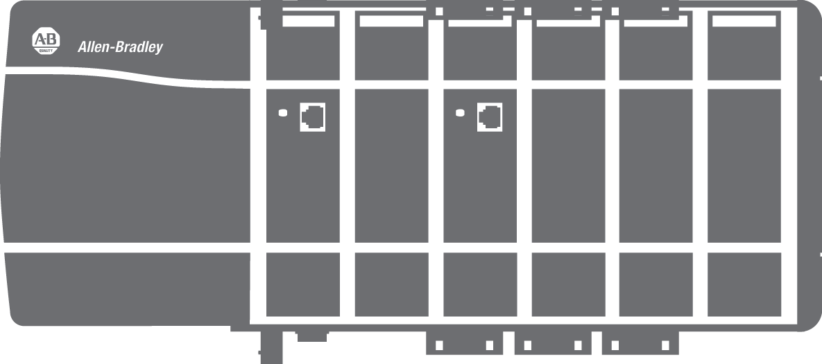
Challenge #2 : Deliver location based content
CHALLENGE
SOLUTION
Long line or machine
Multiple Sections with PLC & Controllers
ONE maintenance technician
Access right PLC program
Operate machine while staying mobile
ThinManager Location Based Content Delivery
QR code, Bluetooth, Wifi, GPS….
Compatible with any Development software
Any mobile device (iOS, Android, Windows)

Slide 10



Challenge #3 : Access Multi-content on HMI
CHALLENGE
SOLUTION
ONE operator
Complex machine multiple tasks
Heterogeneous content sources
ThinManager Multi session / Virtual screen
User Role based
Multi-Technology : RDS, VNC, IP Camera, Web
RFID

Slide 11
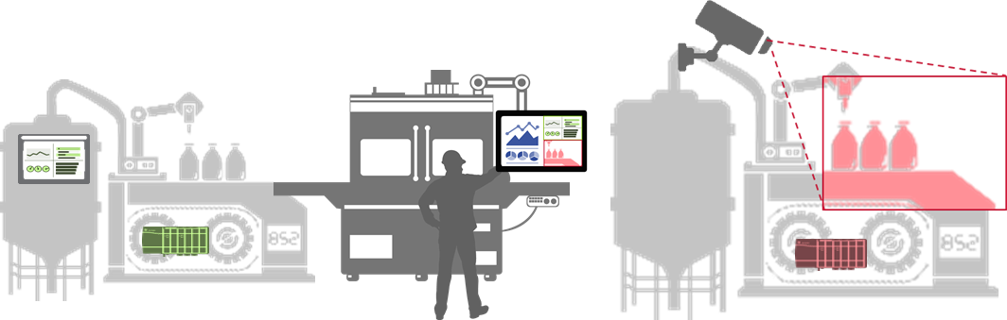
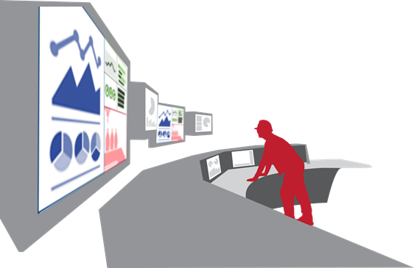
Challenge #4 : Cost efficient Line Integration (HMI)
CHALLENGE
SOLUTION
ONE manufacturing plant
Multiple OEM machines
Single control room, multiple monitors
Access heterogeneous content
ThinManager Multi session / Virtual screen
Multi-display Thin Clients
Multi-Technology : RDS, VNC, IP Camera, Web
NO modification of Machine HMI required
Line #1
Line #2
Line #3

Slide 12
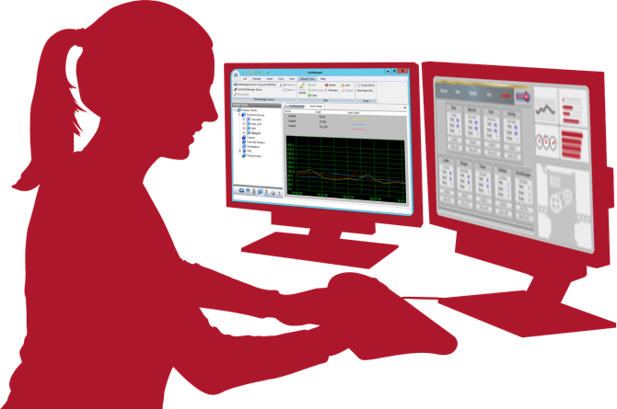


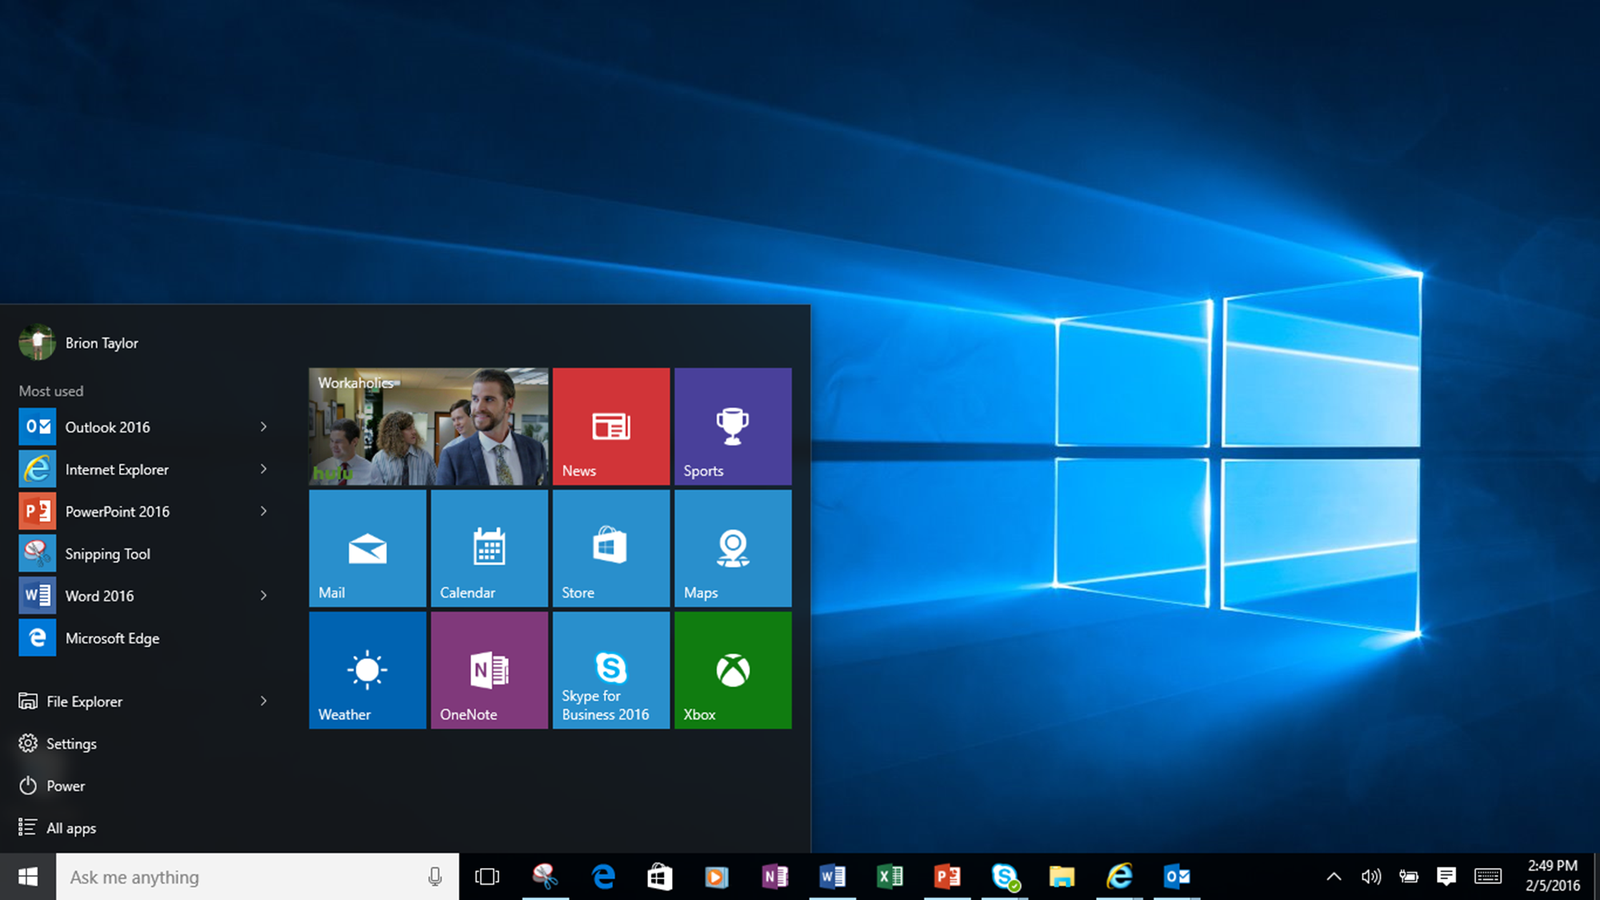





Challenge #5 : Secure your plant floor
CHALLENGE
SOLUTION
Protect sensitive information
Reduce attack surface for malware
Centrally manage operator stations
Prevent access to unauthorized content
Single & corporate access control system
Zero clients without local storage
USB storage devices disabled by default
Built-in Centralized, remote administration & control tool
Remove Windows desktop by isolated Application shortcuts
Native integration with Windows Active Directory
REMOTE ADMIN & CONFIG
REMOTE CONTROL
REMOTE RESTART
Active Directory

Slide 13
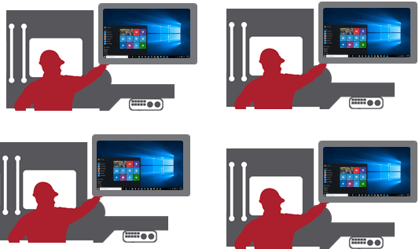

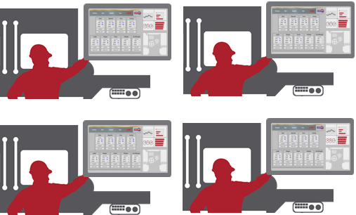

Challenge #6 : Reduce lifecycle management costs
CHALLENGE
SOLUTION
Patch management on every terminal
Application upgrades on every terminal
Typical hardware upgrade frequency: 3 years, to match new OS requirements
Centralized patch deployment on content & RDS server
Centralized Application upgrades on content server
Typical hardware upgrade frequency :10 years
CONTENT SERVER
RDS
SERVER
NO APPLICATION
NO OPERATING SYSTEM

Slide 14
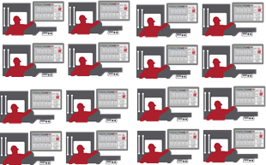
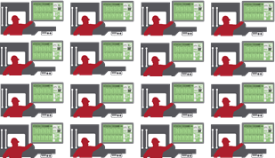
Challenge #7 : reduce downtime during System upgrades
CHALLENGE
SOLUTION
Plant shutdown period during upgrades
Application upgrades on every terminal & server
Limited ability to test upgraded system before final switch to Production state
Centralized Application upgrades on content server
Operator Stations switch instantly between production and upgrade system (and back if needed!)
Production
CONTENT SERVER
RDS
SERVER
CONTENT SERVER
RDS
SERVER
KEEP V9 PROD
ADD V11 TEST
DECOMMISION V9 DEFINE V11 PROD
CONTENT SERVER
RDS
SERVER
1
CONTENT SERVER
RDS
SERVER
CONTENT SERVER
RDS
SERVER
2
CONTENT SERVER
RDS
SERVER
V9 PROD
V9 PROD
V11 TEST
V11 PROD
UPGRADE
& DOWNTIME
V9 PROD
V11 PROD
MULTI - CONTENT
SWIPE
NOTHING TO UPGRADE
NO CLIENT APPLICATION
NO OPERATING SYSTEM
OPERATING SYSTEM
V9 CLIENT APPLICATION
V9 PROD
V11 TEST

Slide 15
Customer Base

Slide 16



















Slide 17


















Slide 18












Slide 19
Release Summary

Slide 20
What’s New in ThinManager Version 11.0 – Dec 2018
GENERAL
PRODUCTIVITY
VISUALIZATION
SECURITY
Localization – Phase 1
UEFI support
Display Client Groups
Display Client Naming
FactoryTalk Activation and Common Installer
FTView licensing improvements
VersaView 5200 support
More flexible touchscreen navigation
MutliMonitor Enhancements
USB badge reader module
MOBILITY
ADDITIONAL
Tiling, Virtual Screens, IP Camera for aTMC, iTMC
TermMon ActiveX Enhancements

Slide 21
What’s New in ThinManager Version 11.1 – July 2019
GENERAL
PRODUCTIVITY
SECURITY
VISUALIZATION
Localized Firmware Package 9
Provide ability to keep hidden RDP sessions alive
Support additional fingerprint readers
Configurable prefix/suffix for mobile clients
PIN complexity and obscurity
NYMI band support phase 1
Freeform MultiMonitor
  Important for 6200T-RE
MOBILITY
ADDITIONAL
iTMC – Camera Support
DDC support for brightness control
Configurable heartbeat for ActiveX control

Slide 22
Hardware Portfolio

Slide 23
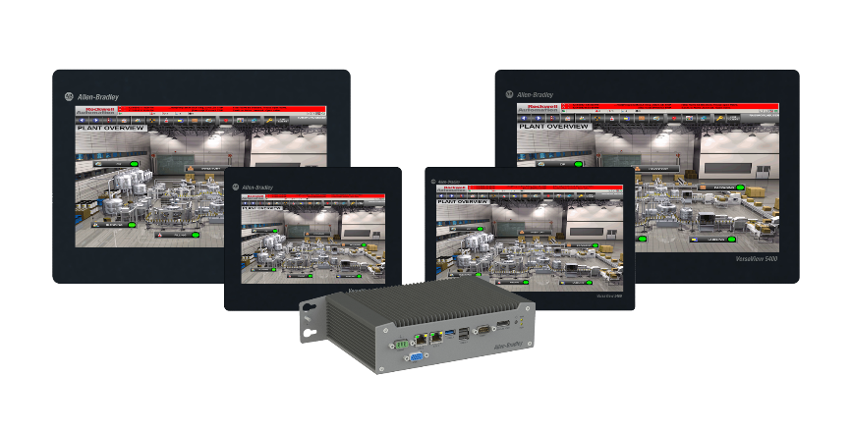
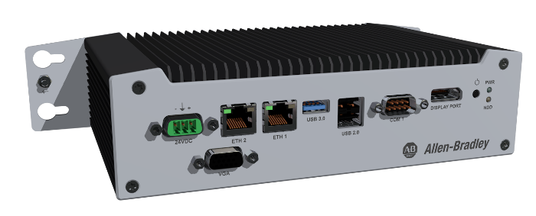
Managed Thin Client Benefits – VV5200
Rockwell Automation® Industrial Thin Client Hardware
Lower total cost of ownership than PCs over the lifetime of the system:
  Integrates with ThinManager® software for efficient centralized management
  Less likely to fail because they don’t have hard drives or fans and they contain industrial grade components suitable for harsh environments
  Easier to replace when they do fail, significantly reducing downtime
  Smaller and require less power to operate and cool
  Fewer client operating systems to manage
More secure:
  No local storage – nothing is stored on device
  Can eliminate access to the Windows Desktop
  USB ports are disabled by default for everything except and keyboards/mice
Notes:
Being ThinManager-Ready means the VersaView series has greater value and functionality than standard commercial grade thin client. ThinManager actually increases the value of the hardware investment by providing additional features and functionality that goes beyond what any unmanaged thin client can do. By combining the VersaView series hardware with ThinManager, customers receive the most powerful thin client solution available for the industrial market.

Slide 24
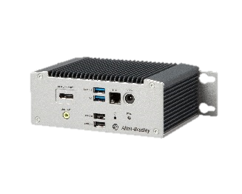
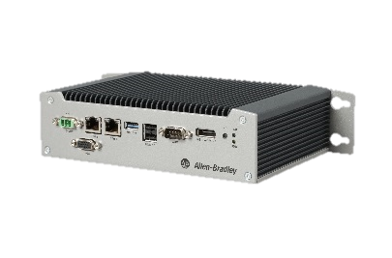
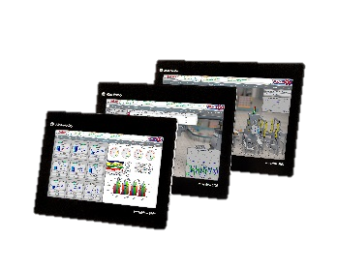
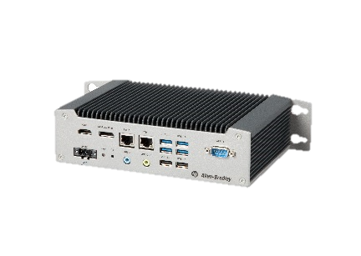
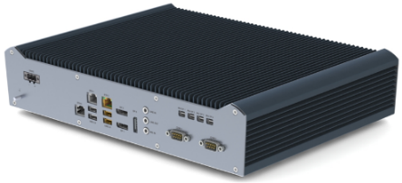
VersaView 5200 ThinManager Ready Industrial Thin Clients
 | VersaView® 5200 Single Display Thin Client | VersaView® 5200 Dual Display Thin Client | VersaView® 5200 Integrated Display Thin Client | VersaView® 5200 Dual 4K Display Thin Client | VersaView® 5200 Multi 4K Display Thin Client
Inputs/Outputs
Video Output | 1x DisplayPort | 1x Digital + 1x VGA | Integrated Display + 1x DisplayPort | 1x DisplayPort (4K) + 1x HDMI (4K) | 3x DisplayPort (4K) or 3x Displayport (4K) + 4x Mini DisplayPort (4K)
USB Ports | 2x USB 3.0 2x USB 2.0 | 1x USB 3.0 2x USB 2.0 | 1x USB 3.0 2x USB 2.0 | 2x USB 3.0 2x USB 2.0 | 2x USB 3.0 4x USB 2.0
LAN | 1x | 2x | 2x | 2x | 3x
Audio | 3.5 mm Out | Over DisplayPort | Over DisplayPort | 3.5 mm Out | 3.5 mm In & Out
COM/Serial | — | 1x | 1x | 1x | 2x
Hardware Design
CPU | Intel Atom E3815 (Single Core) | Intel Atom E3815 (Single Core) | Intel Atom E3815 (Single Core) | Intel Atom E3950 x7 (Quad Core) | Intel i5-7500T (Quad Core)
Thermal Solution | Fanless | Fanless | Fanless | Fanless | Fanless
Power Supply | 5V DC, External Brick | 24V DC, Wide Range | 24V DC, Wide Range | 24V DC, Wide Range | 24V DC, Wide Range
Indicators | Power Switch, Power LED | Power Switch, Power LED | Power Switch, Power LED | Power Switch, Power LED | Power Switch, Power LED
Environmental & Certifications
Operating Temperature | 0-50°C | -20-60°C | 0-50°C | 0-55°C | 0-45°C
Certifications | cULus/CE, KC, BIS, EAC, RCM

Slide 25
Licensing

Slide 26
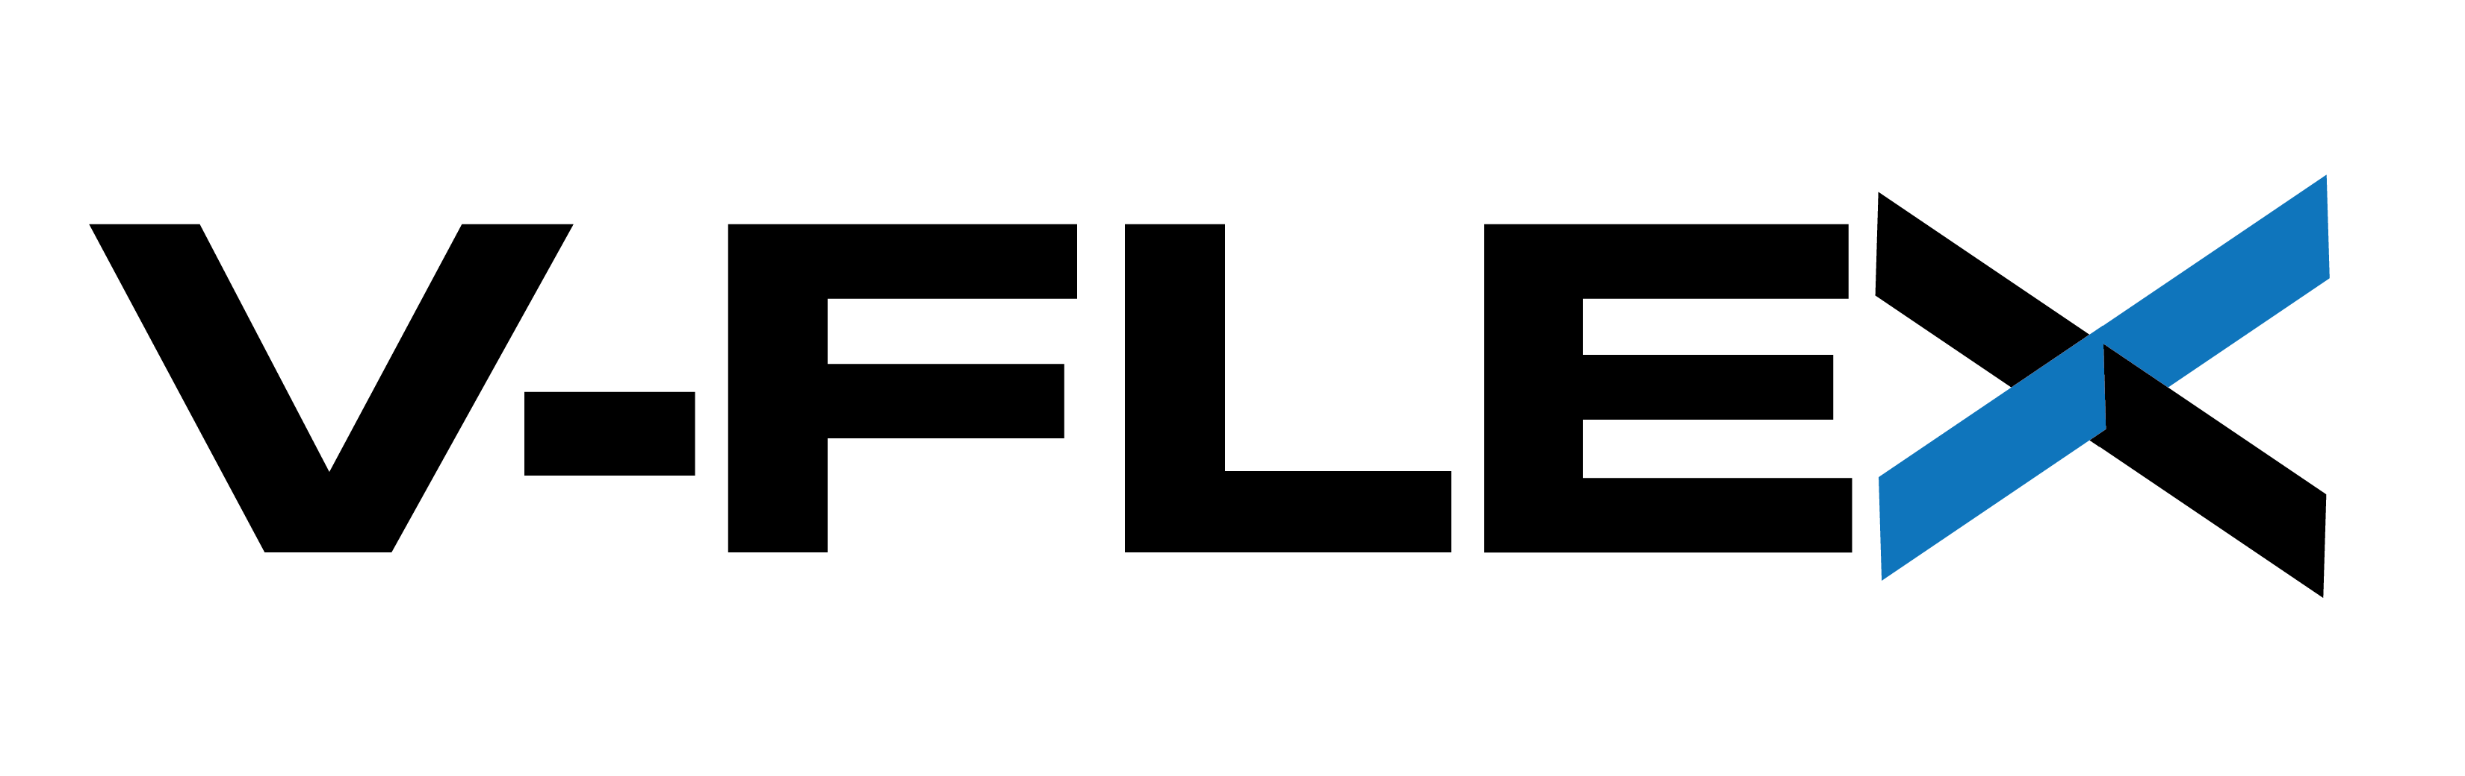
ThinManager V-FLEX Licensing Overview
Users now can purchase single ThinManager connection licenses that have no network or location restrictions and provide for bulk purchase discounts.
ADVANTAGES OF V-FLEX LICENSING:
Central management of ThinManager client connections.
Use across multiple facilities—no limitations on the number of locations, networks and servers.
Ability to purchase and add additional licenses only when and where they are needed with volume discount pricing.
Access to a private ThinManager license server portal for creating and distributing licenses for use.
Deliver ThinManager client connections with maximum flexibility on an as-needed basis to any of your facilities around the world.
ThinManager V-FLEX licensing is a single ThinManager XLr individual terminal connection license that can be purchased one-at-a-time in any quantity.
They can be deployed over an unlimited number of ThinServer pairs (primary/backup) at an unlimited number of locations on multiple networks.
Notes:
How is it Licensed?
ThinManager is licensed based on 3 factors:
Terminal Connection License
Redundancy
Platform Maintenance
The Terminal Connection License is defined by how many terminals/devices are concurrently connected to ThinManager. These are sold in 5, 10 and 25 packs (which are additive) as well as an Enterprise Server license that provides Unlimited Terminal Connections.
Redundancy provides a pair of ThinManager installations that are automatically synchronized. Either installation can deliver firmware and terminal profiles.
Platform Maintenance is equivalent to TechConnect. In exchange for annual fee, the end user receives the latest version of ThinManager, Live Tech Support and trade-in value for their license towards an Enterprise Server license.
Redundancy is having 2 ThinManager installations that are automatically synchronized -> either of which can deliver firmware and profiles to the terminals managed by ThinManager.
None
Mirrored – provides a pair of ThinManager installs which are automatically synchronized, but there is a restriction - changes to the ThinManager configuration can only be made from the Primary ThinManager installation
Full – similar to Mirrored except there is no restriction – ThinManager configuration changes can be made from either ThinManager installation
Platform Maintenance (PM) is ThinManager’s form of TechConnect. This is an annual fee that provides the latest release of ThinManager, access to live tech support, and credit towards upgrades in the future.
There are 3 special licenses available:
Muni Pack – offered only in 25 terminal connection counts and for municipalities only – can split the terminal connection count across multiple sites. Can be purchased with No Redundancy or Full Redundancy only.
Enterprise Server – provides an unlimited number of terminal connections on a single owned network. Includes Full Redundancy and 1st Year of Platform Maintenance. Restriction: Cannot be used on networks that are public, leased or non-company owned.
FLEX (100, 250, 500) – provides a terminal count limit, but can be installed on as many networks as needed. RESTRICTION: Can only be utilized within a single Business Unit of a company.

Slide 27

ThinManager V-FLEX Licensing Overview
Both FTA and TMA are available in two formats:
  Perpetual+Maintenance
  Subscription exclusively through the software portal.
Activation
  V-FLEX TMA is activated through the licensing.thinmanager.com ThinManager Licensing Website.
  V-FLEX FTA is activated either through FactoryTalk Activation Manager or the activate.rockwellautomation.com FTA Website.
Redundancy
  This Redundancy Companion license is sold separately and cannot function independently since it is sold for a 50% reduced cost.

Slide 28
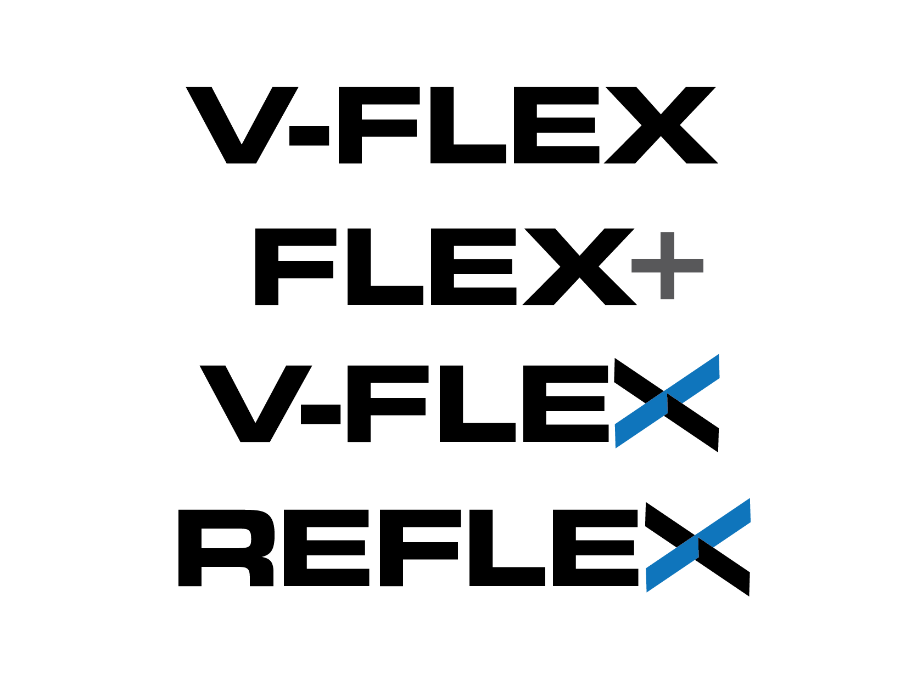
Introducing ThinManager Versatile FLEX Licensing “V-FLEX”
Flexible now means Versatile when it comes to ThinManager licensing
Users now have the ability to purchase single ThinManager connection licenses that have no network or location restrictions and provide for bulk purchase discounts.
Based on 2 primary catalog numbers – a 1 terminal connection license and an optional companion license for redundancy.
Customers can order in specific quantities (not just limited to multiples of 5).
All licenses will be FLEX which allows customers to break up the quantities ordered as they see fit.
Access to the FTA license portal for creating and distributing licenses for use.
No limitations on the number of locations, networks or servers.
Purchase and add additional licenses only when and where they are needed.
Volume discount scale based on the number of terminal connections.
Introduction of a dependent redundancy license at 0.5 the cost of the base license.
8x5 Software Maintenance will be the default and included for the 1st year on all new license purchases.
Elimination of Enterprise Server offering on Aug 26, 2019.
NEW V-FLEX LICENSING
Sold as individual terminal connection licenses to use across multiple facilities with volume purchase discounts

Slide 29
V-FLEX License Model
Price Bands for Perpetual + Maintenance
Catalog Numbers for FTA:
9541M-TMFT11 (8x5)
9541M-TMFT12 (24x7)
9541-TMFRP
(Redundancy Add On)
Catalog Numbers for TMA:
9541-TMF1-TMA (8x5)
9541-TMF1-247-TMA (24x7)
9541-TMFR1-TMA
(Redundancy Add On)
where “F” = FLEX, “R” = Redundancy,
“TMA” = ThinManager Activation
Terminal Count | Multiplier | Price per Terminal (includes 8x5 Software Maintenance) | Price per Terminal (includes 24x7 Software Maintenance) | Redundancy Adder per Terminal | Breakpoint
1-4 | 1.00 | $2,400.00 | $2,600.00 | $1,000.00 | 3
5-49 | 0.55 | $1,320.00 | $1,430.00 | $550.00 | 46
50-99 | 0.50 | $1,200.00 | $1,300.00 | $500.00 | 81
100-249 | 0.40 | $960.00 | $1,040.00 | $400.00 | 219
250-499 | 0.35 | $840.00 | $910.00 | $350.00 | 429
500+ | 0.30 | $720.00 | $780.00 | $300.00 | N/A
Pricing in the 1-4 band is by design to maintain the 5-pack entry point.
The Breakpoint column indicates the count at which it is more cost effective to move to the next price band.
V-FLEX licensing is purchased though the eCommerce portal at: https://commerce.rockwellautomation.com.

Slide 30
V-FLEX Software Maintenance
Software Maintenance is the new Platform Maintenance
The 1st year of 8x5 Software Maintenance is included in all new V-FLEX licensing purchases, with an option for 24x7.
24x7 Software Maintenance is also offered on initial purchases.
For 24x7 on initial purchases, order these catalogs instead of the standard catalog numbers:
  FactoryTalk Activation:
  9541M-TMFT12 (configured through the eCommerce portal)
  9541-TMFRP (configured through the eCommerce portal)
  ThinManager Activation:
  9541-TMF1-247-TMA
  9541-TMFR1-TMA
Software Maintenance Renewal catalog numbers – order in correct quantities:
  9542-TMF1-SMR (or 9542-TMF1-247-SMR for 24x7)
  9542-TMSVR-SMR (or 9542-TMSVR-247-SMR for 24x7)
  9542-TMSTE-SMR (or 9542-TMSTE-247-SMR for 24x7)
NEW V-FLEX LICENSING
Sold as individual terminal connection licenses to use across multiple facilities with volume purchase discounts

Slide 31
V-FLEX Subscription
Price Bands for Subscription
Terminal Count | Multiplier | Price per Terminal (includes 8x5 Software Maintenance) | Price per Terminal (includes 24x7 Software Maintenance) | Redundancy Adder per Terminal | Breakpoint
1-4 | 1.00 | $800.00 | $1,000.00 | $400.00 | 3
5-49 | 0.55 | $440.00 | $550.00 | $220.00 | 46
50-99 | 0.50 | $400.00 | $500.00 | $200.00 | 81
100-249 | 0.40 | $320.00 | $400.00 | $160.00 | 219
250-499 | 0.35 | $280.00 | $350.00 | $140.00 | 429
500+ | 0.30 | $240.00 | $300.00 | $120.00 | N/A
Catalog Numbers:
9541C-TMFT11 (8x5)
9541C-TMFT12 (24x7)
9541-TMFR (Redundancy Add On)
Quotes and purchases for FTA V-FLEX licenses are created and completed on eCommerce portal at https://commerce.rockwellautomation.com
The Breakpoint column indicates the count at which it is more cost effective to move to the entry point of the next price band.
24x7 subscription is a 25% adder to the Price per Terminal.
Subscription is only offered with FactoryTalk Activation.

